Slide 1
Appendix C
MATLAB’s Simulink Tutorial

Slide 2
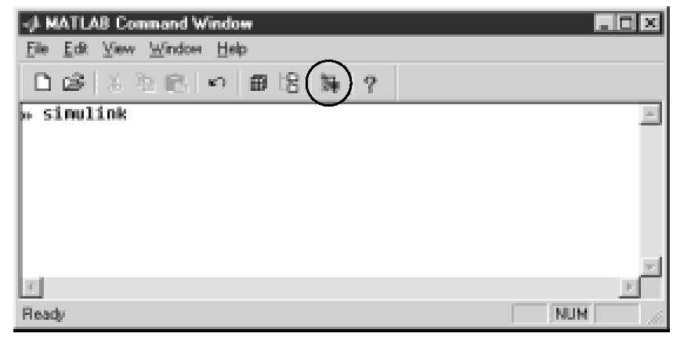
Figure C.1
MATLAB Command
Window showing how
to access Simulink.
The Simulink Library
Browser button is
shown circled

Slide 3
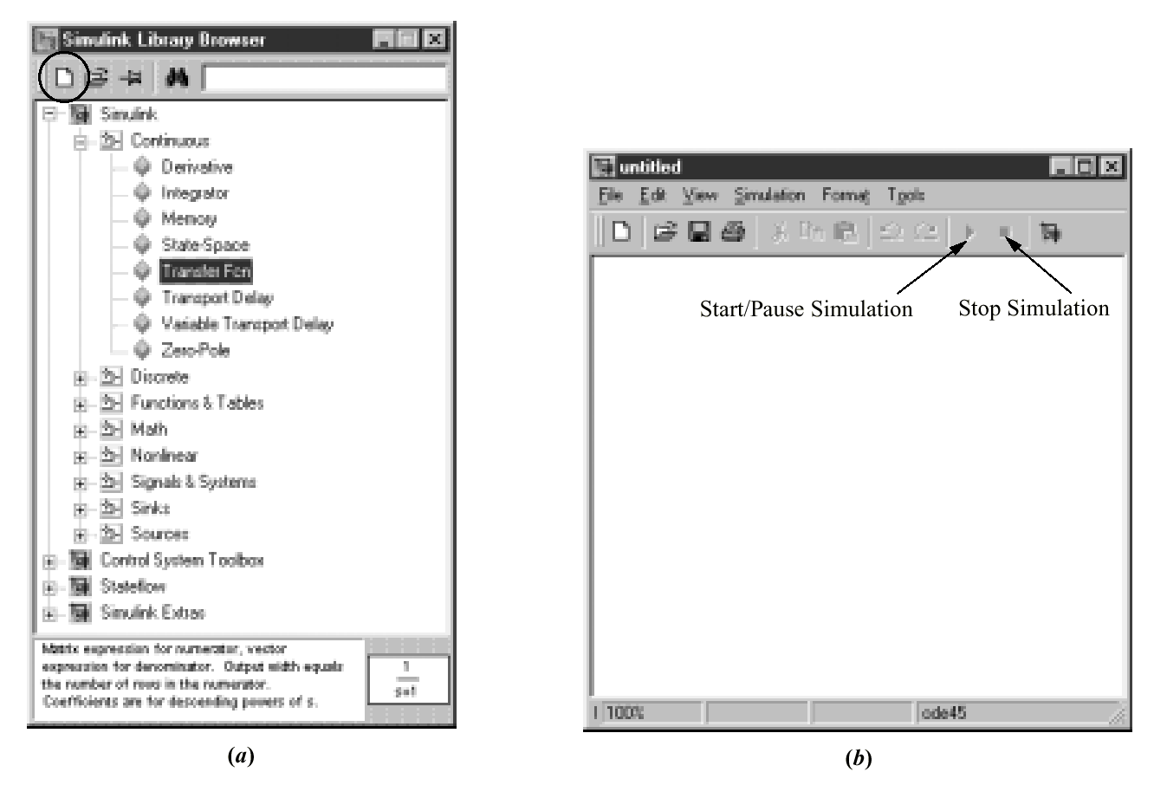
Figure C.2
Simulink Library
Browser
window showing:
a. the Create a
new model
button
encircled;
b. resulting
untitled model
window

Slide 4
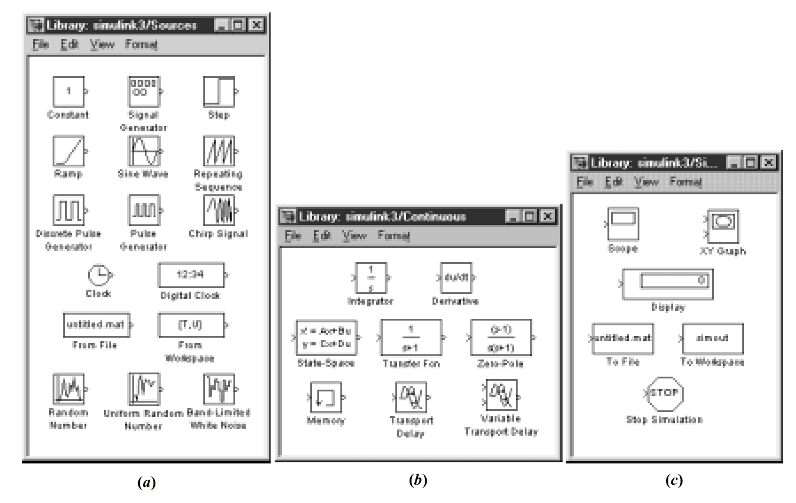
Figure C.3
Simulink libraries:
a. sources;
b. continuous systems;
c. sinks

Slide 5
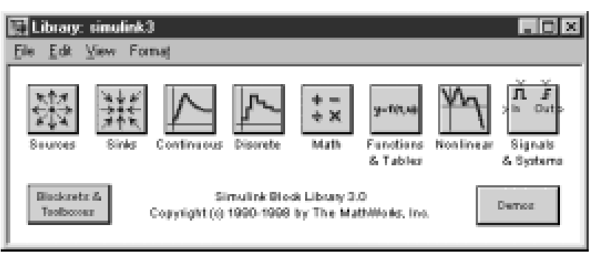
Figure C.4
Simulink Block
Library window

Slide 6
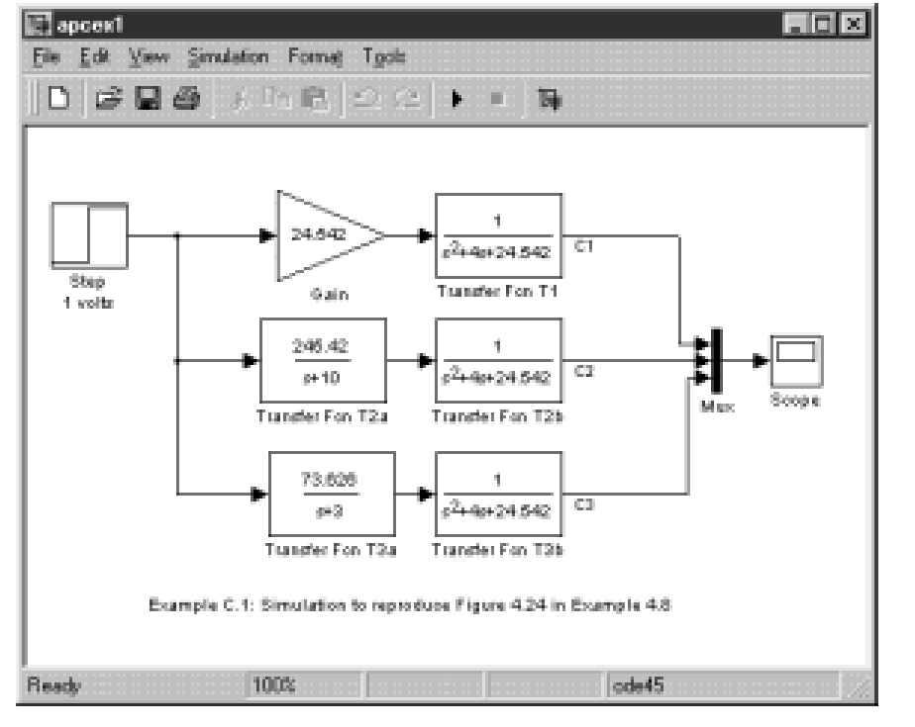
Figure C.5
Simulink block
diagram for
Example C.1

Slide 7
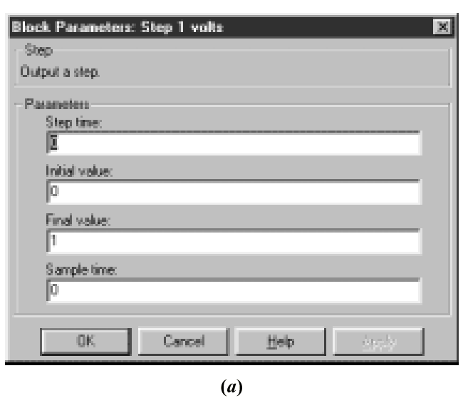
Figure C.6
Block Parameters
windows for:
a. 1 volt step source;
(figure continues)

Slide 8
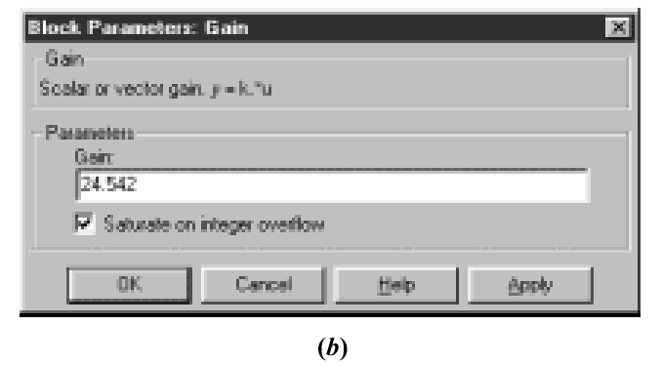
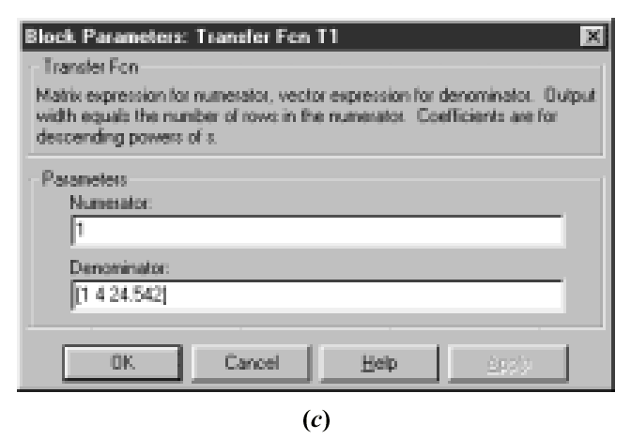
Figure C.6
(continued)
b. gain;
c. transfer
function 1;

Slide 9
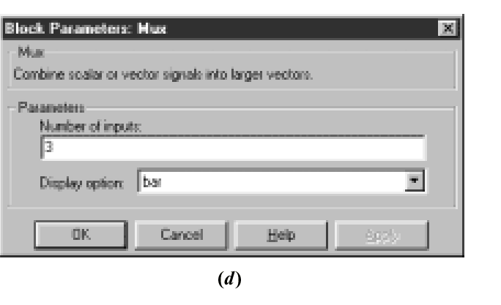
Figure C.6
(continued)
d. mux

Slide 10
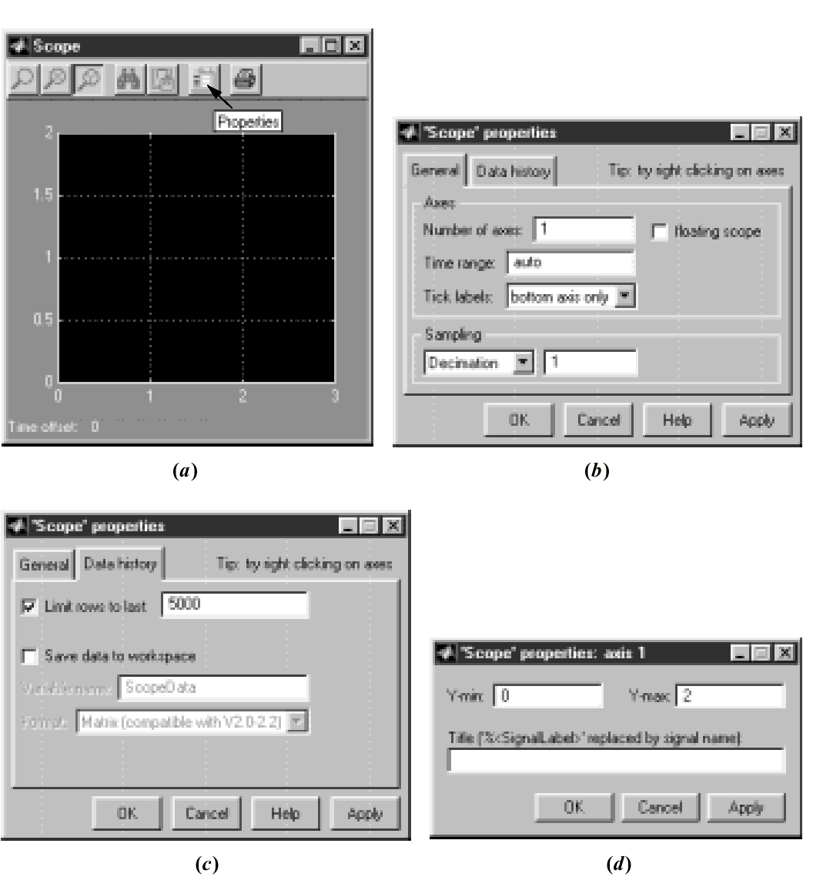
Figure C.7
Windows for the
scope:
a. Scope;
b. ‘Scope’
properties,
General tab;
c. ‘Scope’
Properties,
Data history tab;
d. ‘Scope’
properties: axis 1

Slide 11
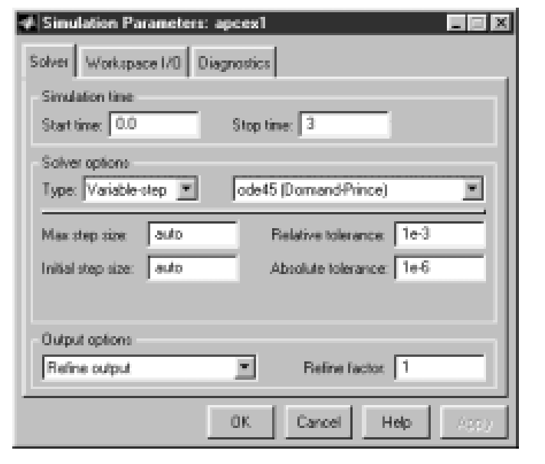
Figure C.8
Simulation
Parameters
window
for Solver
tab

Slide 12
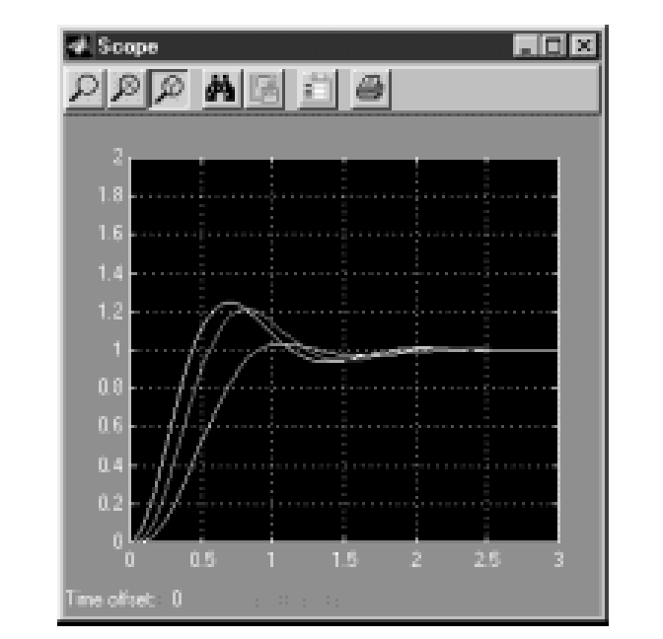
Figure C.9
Scope window
after Example C.1
simulation stops

Slide 13
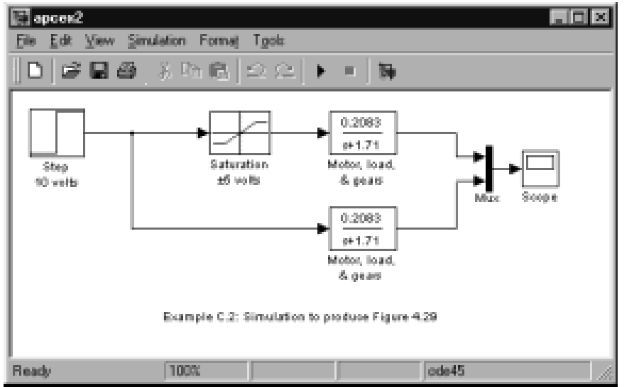
Figure C.10
Simulink block
diagram for
Example C.2

Slide 14
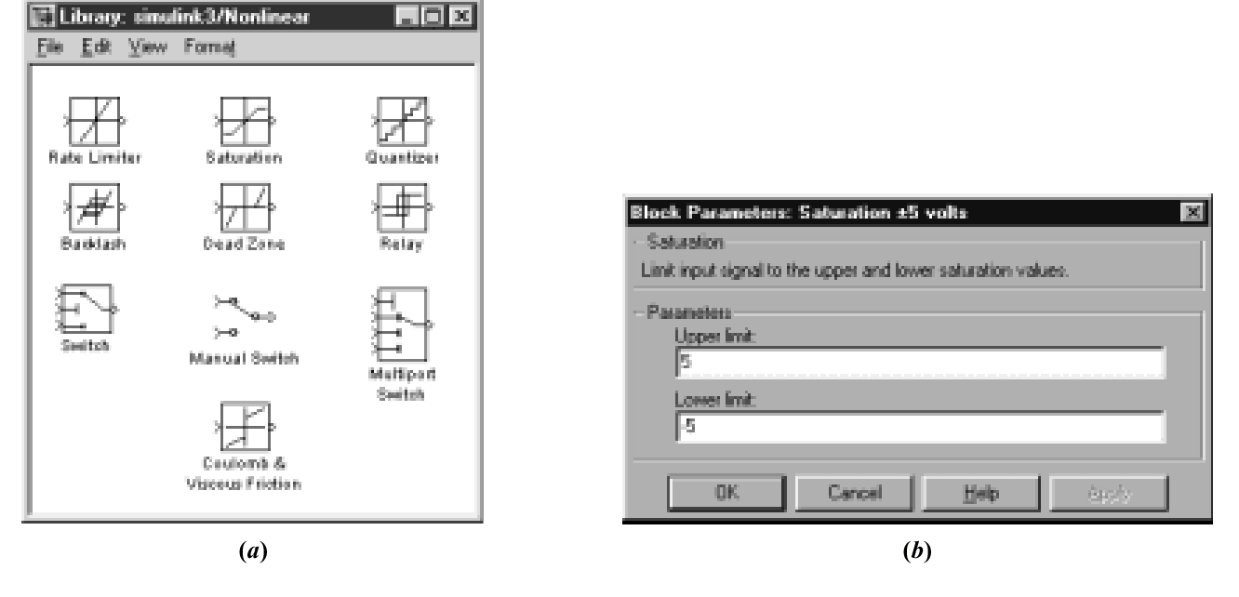
Figure C.11
a. Simulink library for
nonlinearities;
b. parameter settings
for saturation

Slide 15
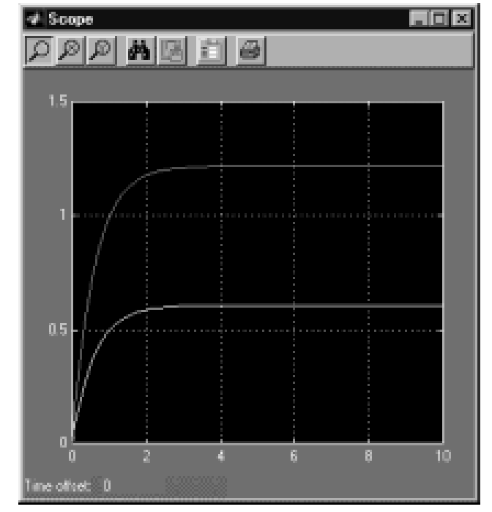
Figure C.12
Scope window after
simulation of Example
C.2 stops. The bottom
curve is the output
with saturation

Slide 16
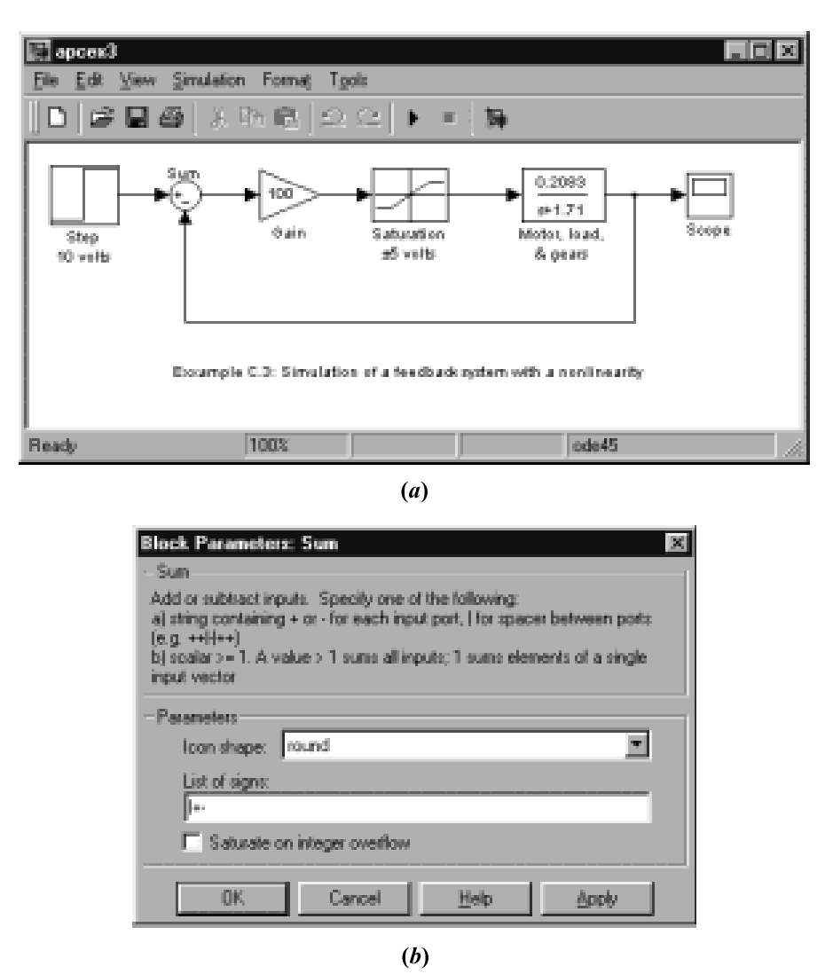
Figure C.13
a. Simulation block
diagram for a
feedback system
with saturation;
b. block parameter
window for the
summer

Slide 17
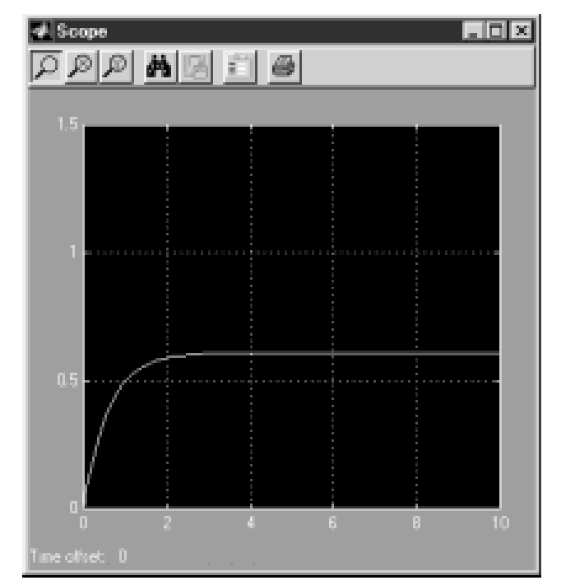
Figure C.14
Simulation output
for Example C.3

Slide 18
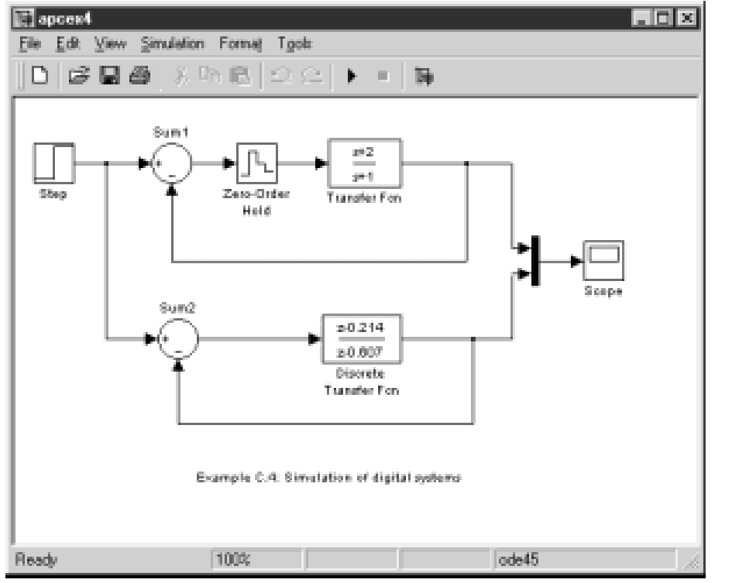
Figure C.15
Simulink block
diagram for
simulating
digital systems
two ways

Slide 19
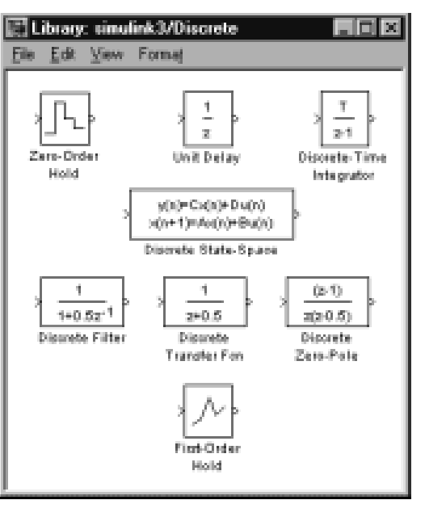
Figure C.16
Simulinks library of
discrete parts

Slide 20
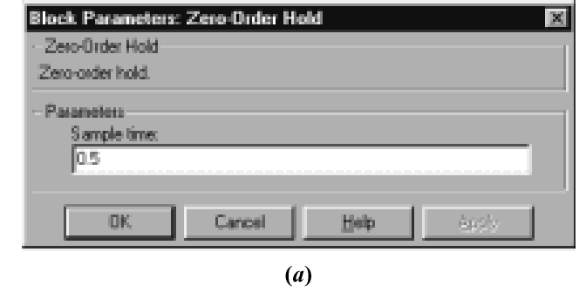
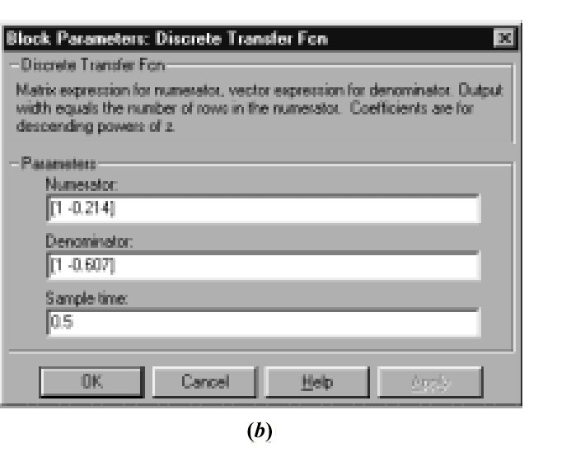
Figure C.17
Block Parameter
windows for:
a. Zero-Order Hold
block;
b. Discrete Transfer
Fcn block

Slide 21
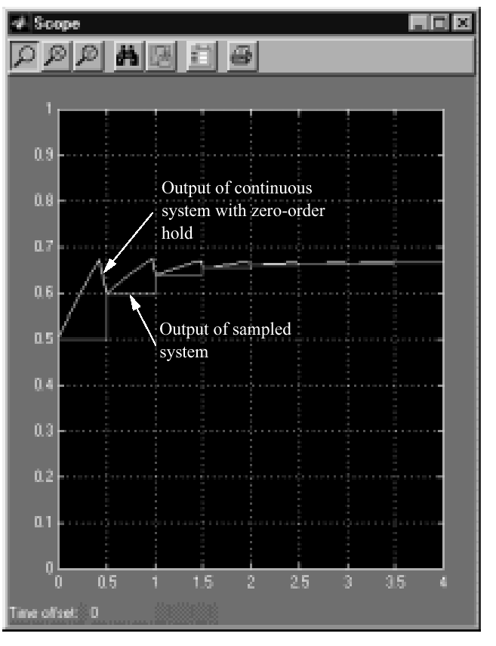
Figure C.18
Outputs of the
digital systems

